Slide 1
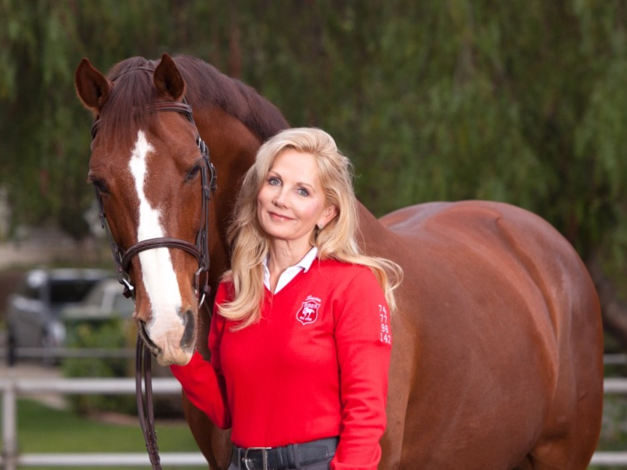
WHERE RESCUE is ONLY the BEGINNING
How Not to be Your Own Volunteer: Recruiting, Training, Retaining a Solid Volunteer Core
Presented by: Susan Peirce
President/Founder
Red Bucket Equine Rescue

Slide 2
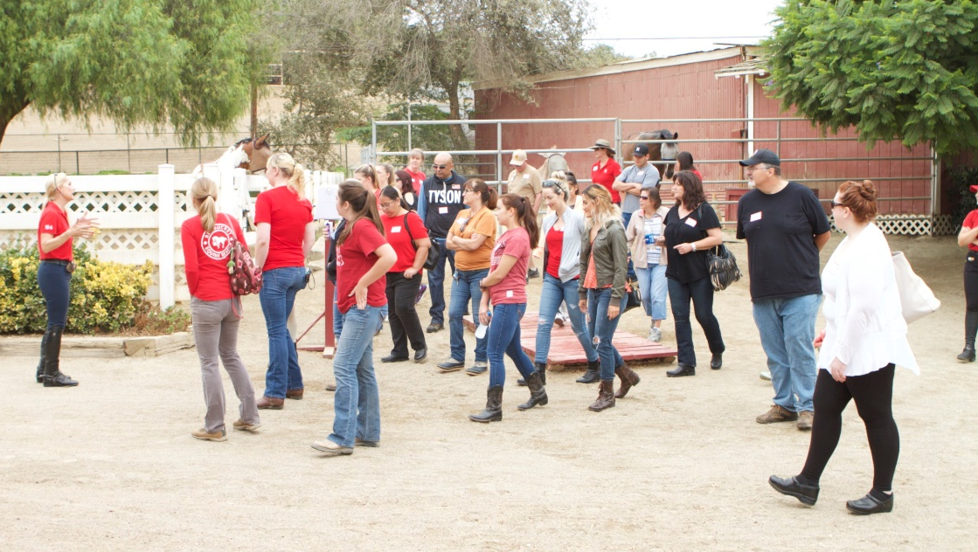
Orientation Begins: Day One
Application
Welcome and Invitation
Monthly New Team Member Orientation
History…the “why” behind
Mission, Vision, Values
Culture
Expectations
Dress code
Conduct
Commitment and Character
Tour
Sign-up Opportunities
Selection is a two-way street

Slide 3
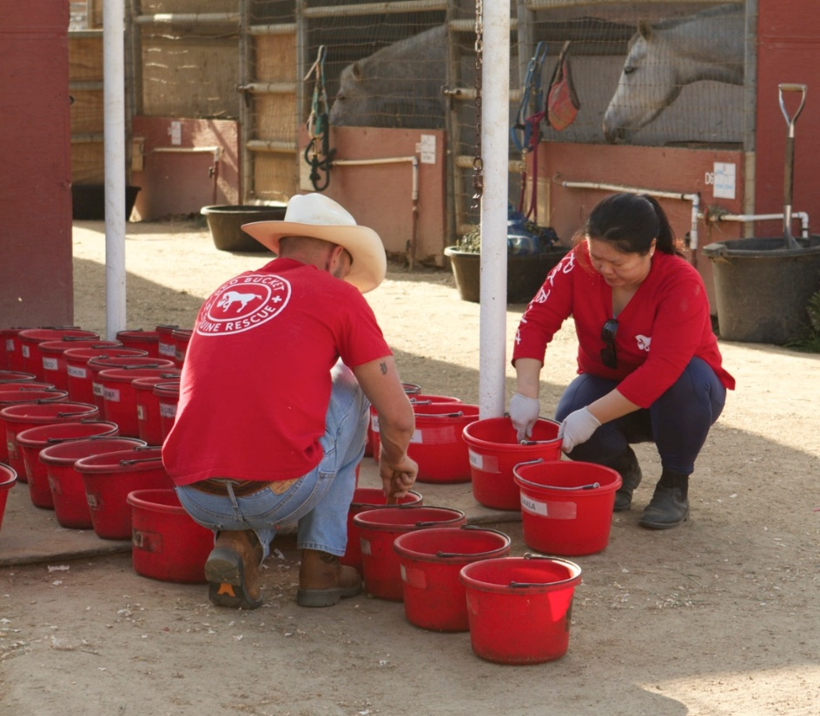
Culture Precedes…Everything!
Culture is Defined as: “how we do things around here”
Culture is considered to be the most important element in healthy organizations
Culture is Intentional
Every Strong Culture has Its Own Language
What is the Language of Red Bucket?

Slide 4
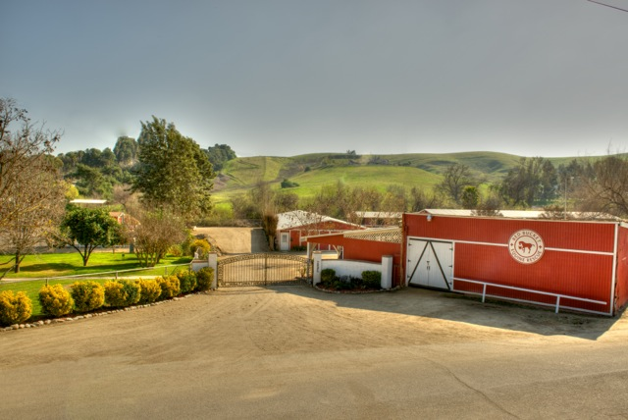
The Language of Red Bucket: “Welcome to the Ranch the Horses Own”

Slide 5
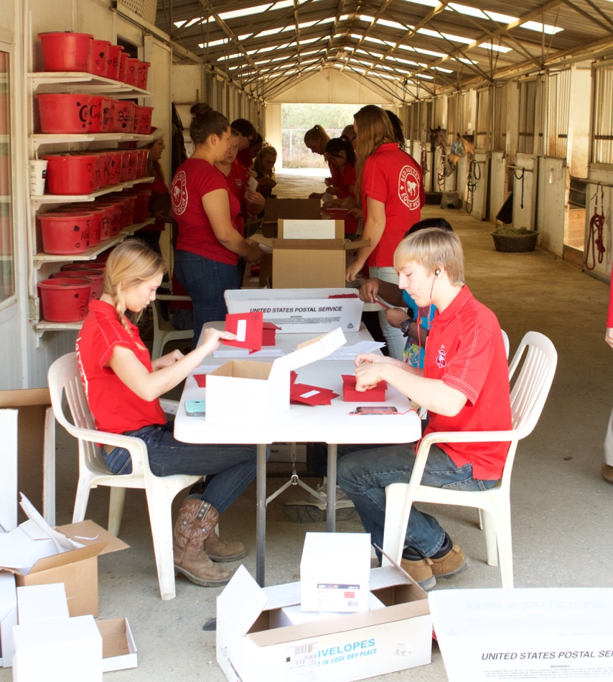
“We Serve Our Horses, One Another and Our Community”

Slide 6
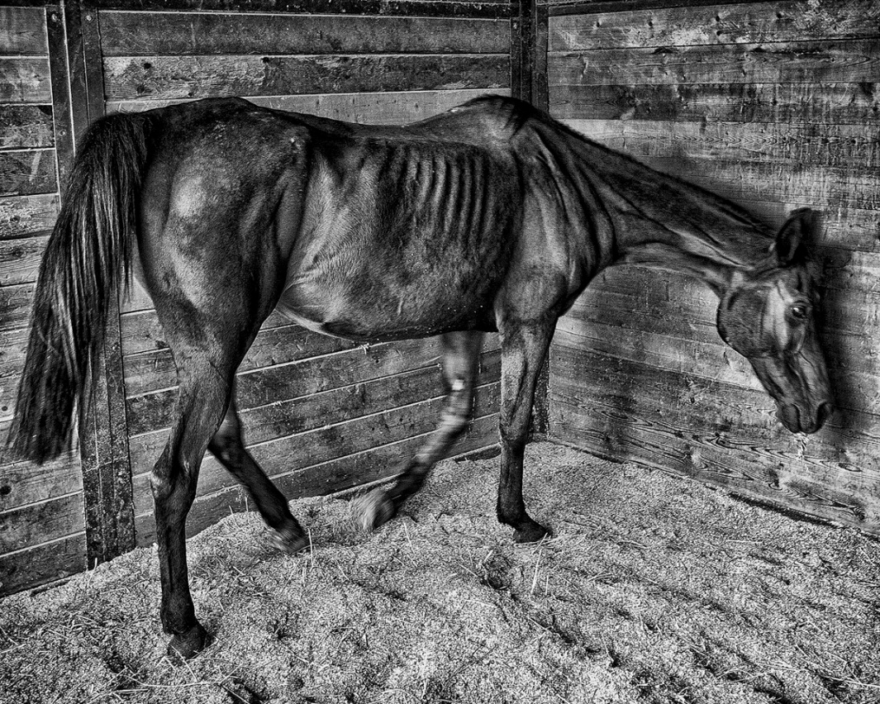
“We Just Saved Another Horse”

Slide 7
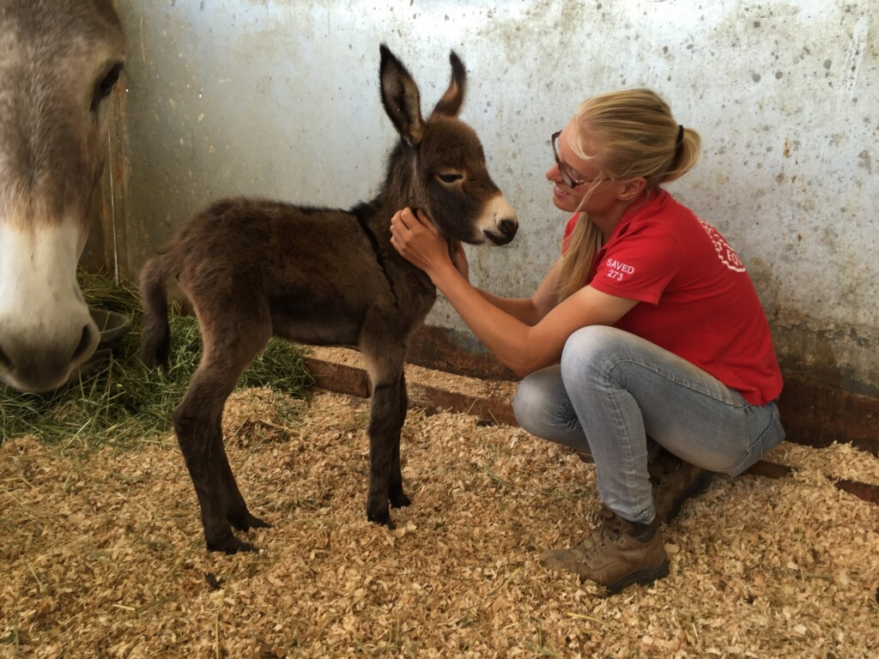
“We Just Had a New Baby”

Slide 8
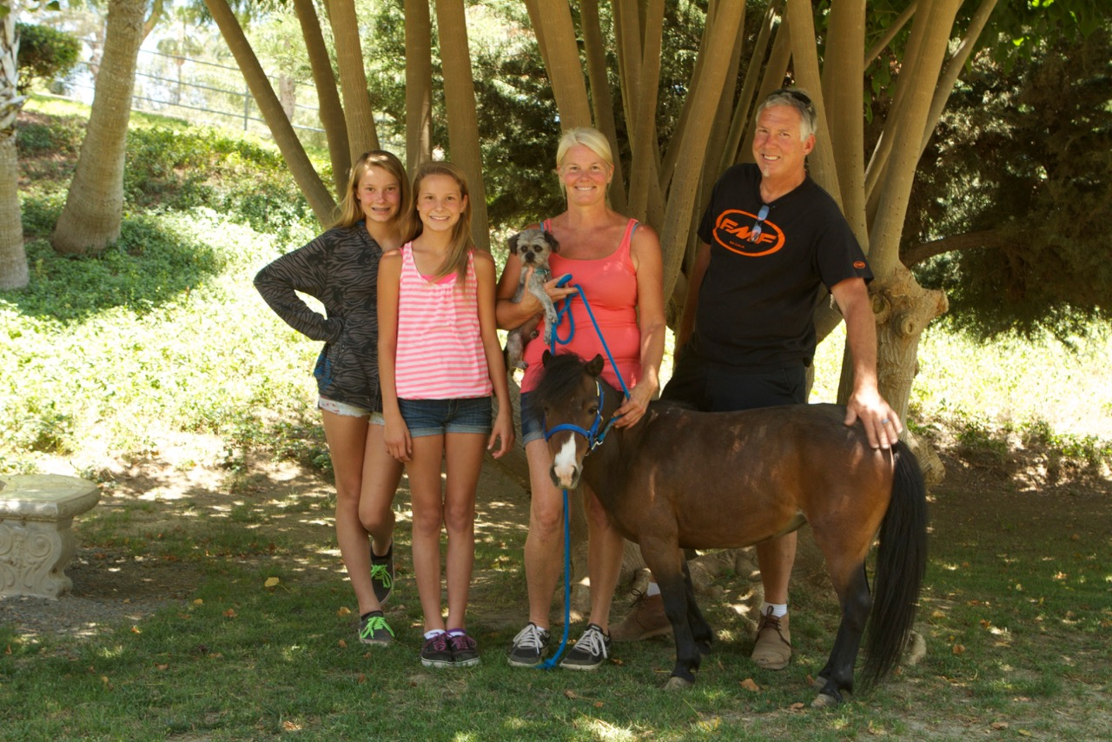
“We Just Got a Horse a New Home”

Slide 9
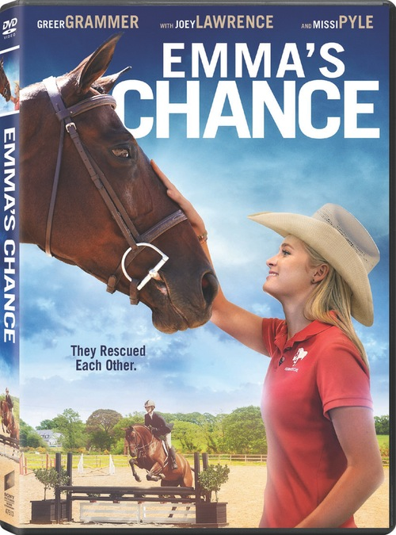
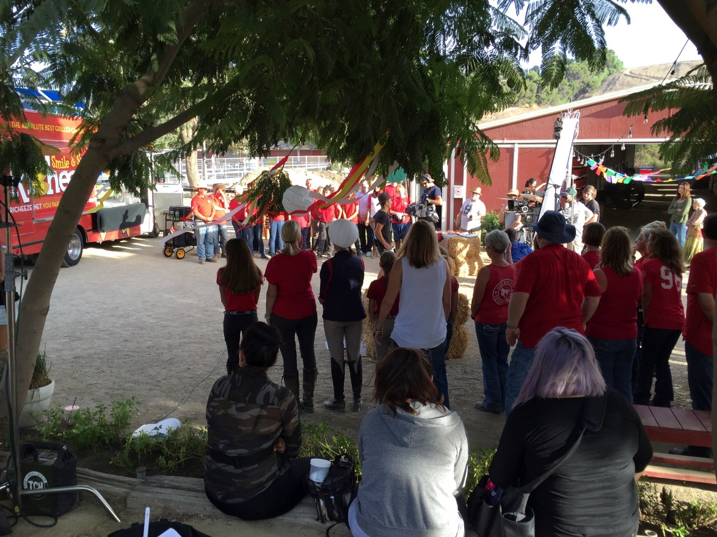
“We Made A Movie”

Slide 10
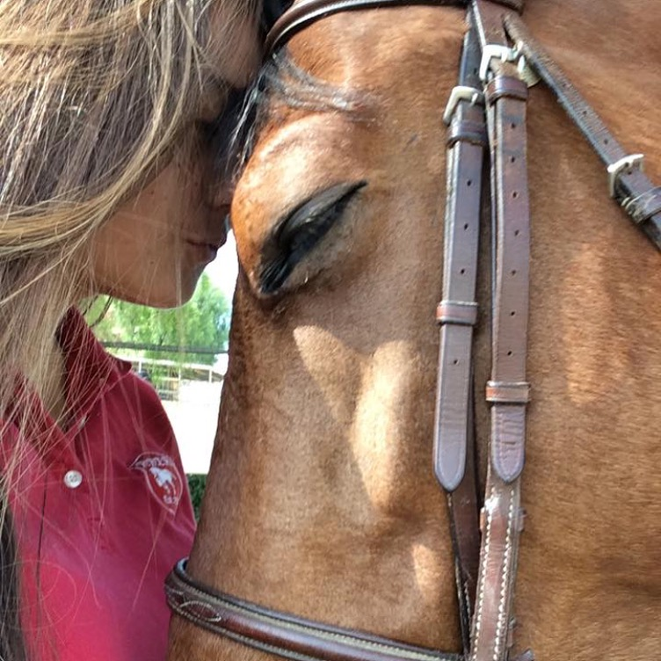
We Spend a lot of time talking about the horses…Let’s focus on the people:
Fundamentals of Human Behavior: All behavior is designed to find meaning

Slide 11
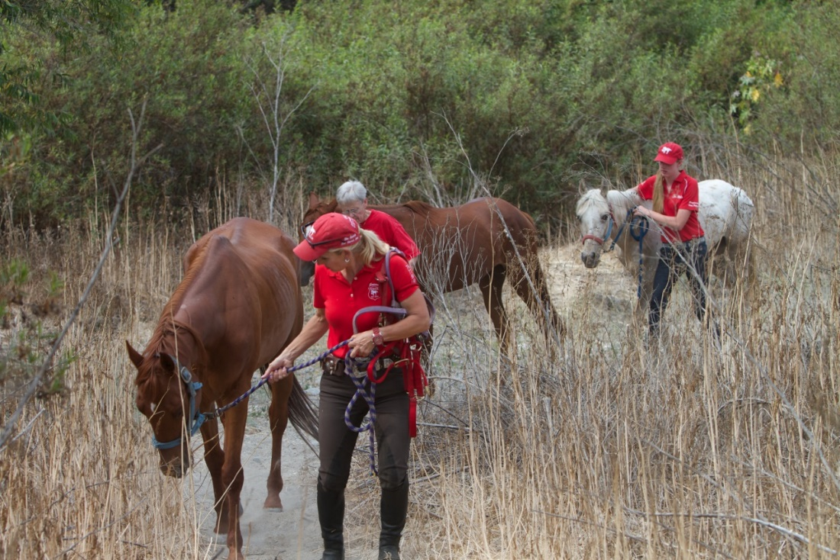
Why Do People Volunteer?
They want to do something to bring meaning to their lives
They want to be bigger than themselves
Connect their gifts to something that makes a difference

Slide 12
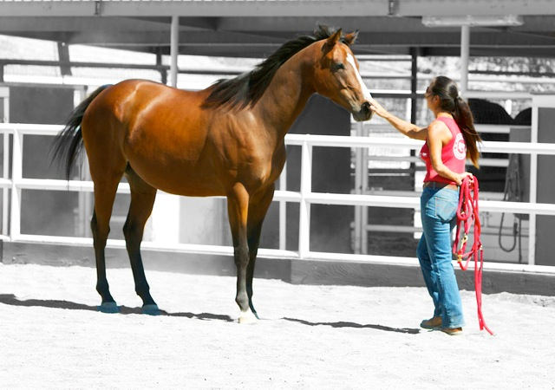
Boots on the Ground Enrichment
People want to belong to something meaningful
At a core level people want to give
Most people are not “fed” when they give/volunteer

Slide 13
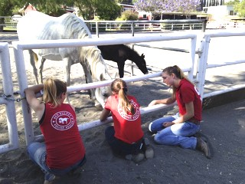
The Golden Rule
People want to be treated like they are healthy!
I’m OK, You’re OK
The Truth is at the core of Human Enrichment

Slide 14
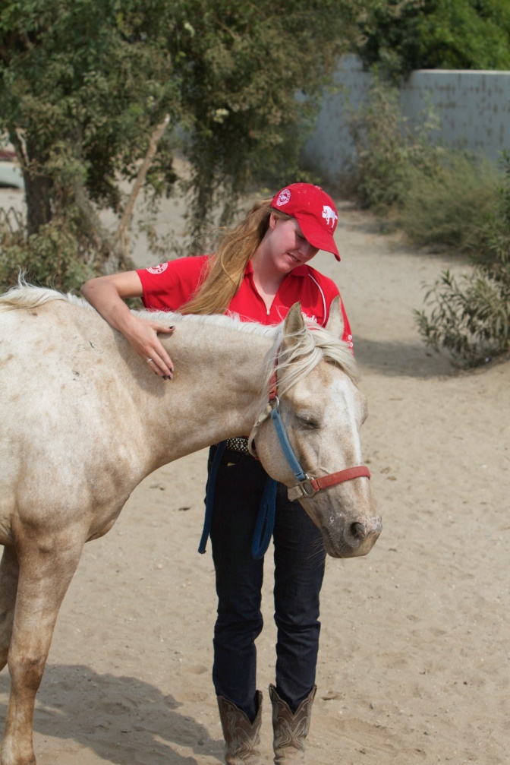
In Leading Volunteers…Feed Natural Human Desires
People Want:
To be given goals
Feedback systems
To learn
To be part of authenticity, something meaningful…to matter!

Slide 15
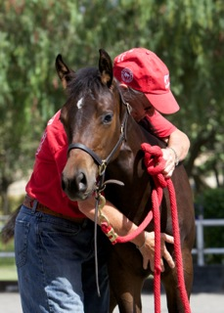
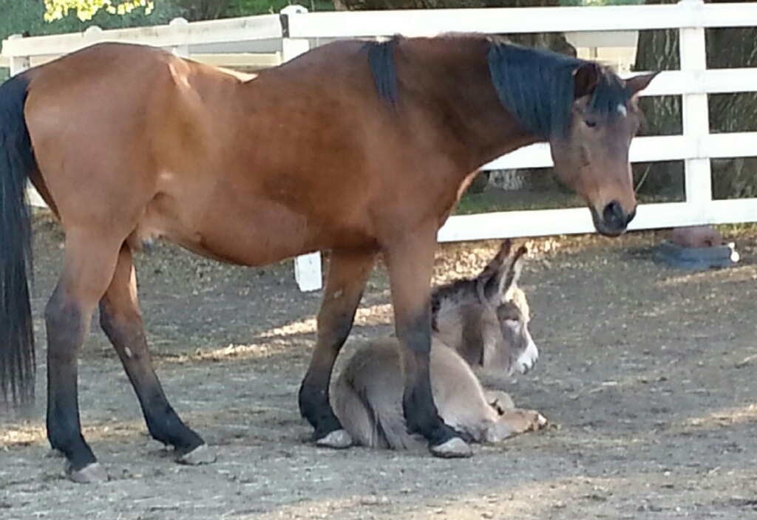
Create an Environment that Invites Them to be Their Best… and an Environment that is Safe!

Slide 16
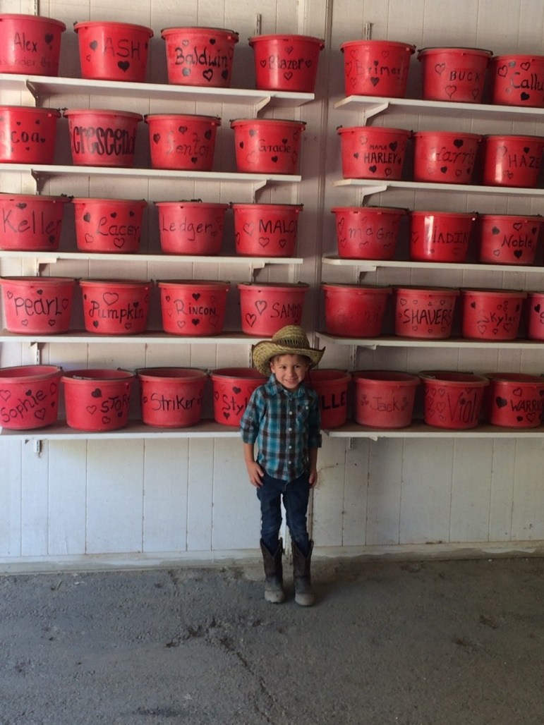
When Loss Occurs
Provide a Forum for Grief
Process depression, anger, and "why are we doing this…?"
Create a sense of community
Pay respect for the horse
Heal through stories, memories, and connect back to ..."why we are doing this...!"

Slide 17
A Leader
Deeply encourages & inspires others:
team members
staff
donors
community
Invites the very best
Provides the "why" behind everything
Connects the dots
Role models what “good” looks like ....
Demonstrates Accountability
Helps the Organization Learn from failure

Slide 18
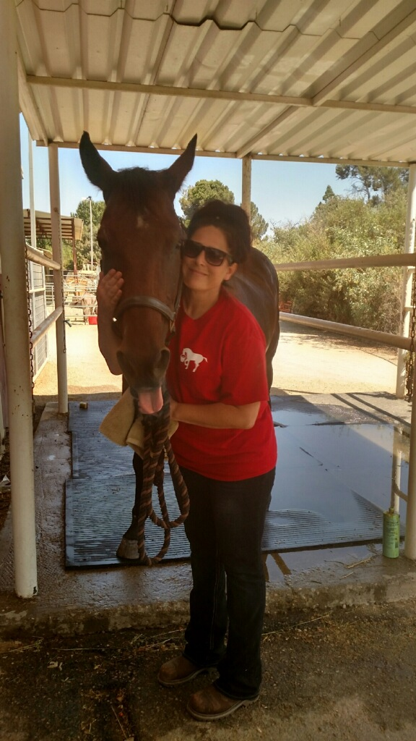
Examples of Enrichment at Red Bucket
Curry Comb Club
Fire Side Chats
Cross Tie Clinics
Team Member/Volunteer Newsletter Highlights
“Round-Ups”
Guardian Horses…and Donkeys
Promotions
Meetings, Team Operations, Leadership
Invitations
Internships
Training
The Jr. Reds
Family BBQ’s
Memorials
Summits

Slide 19
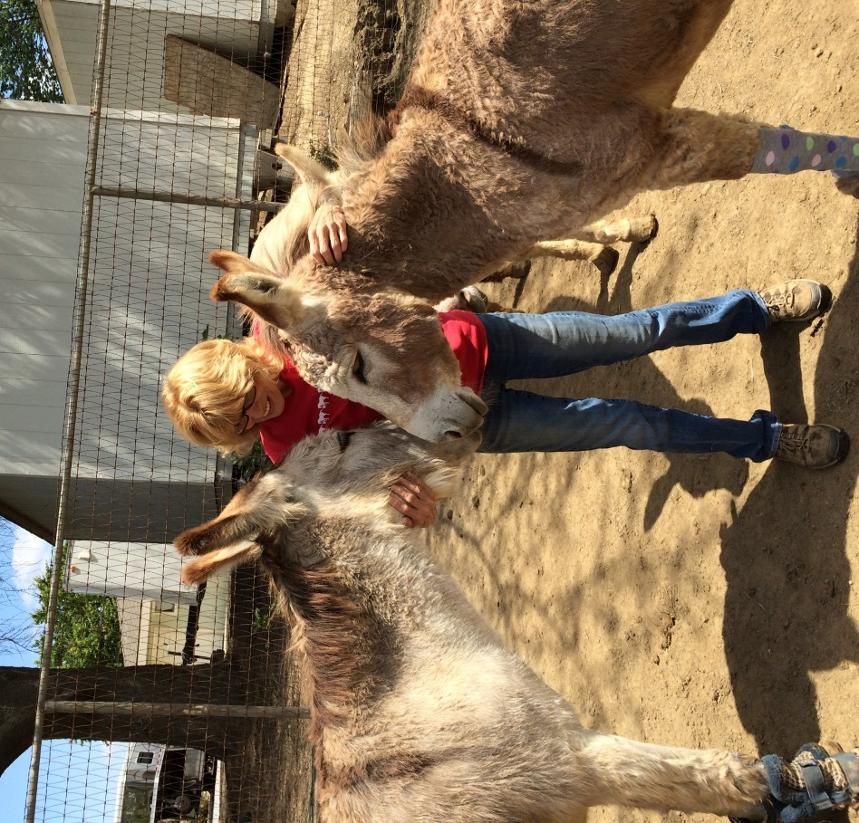
How Not to be Your Own Volunteer? Give…Give...Give
Leadership Roles
Clarity…Mission, Vision, Values; Roles and Responsibilites; Expectations
Knowledge
A Voice-Solution Orientation
Ownership

Slide 20
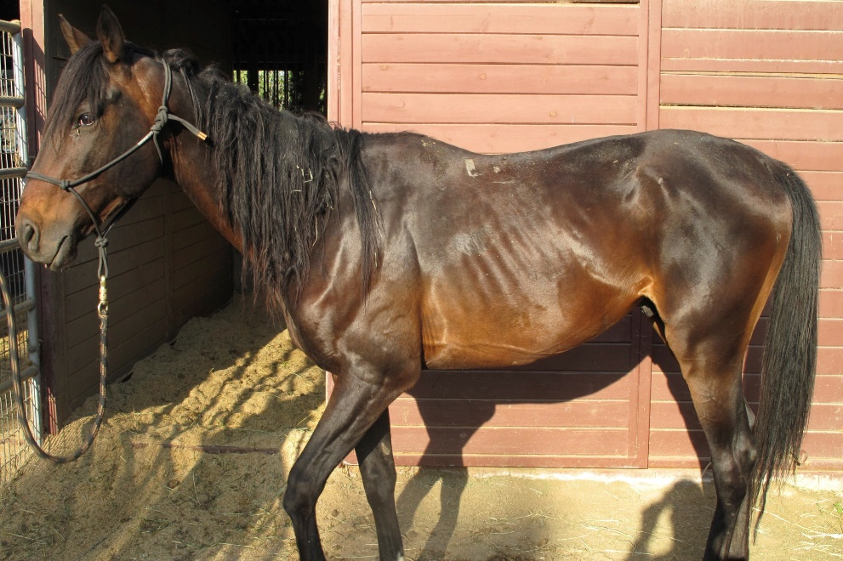
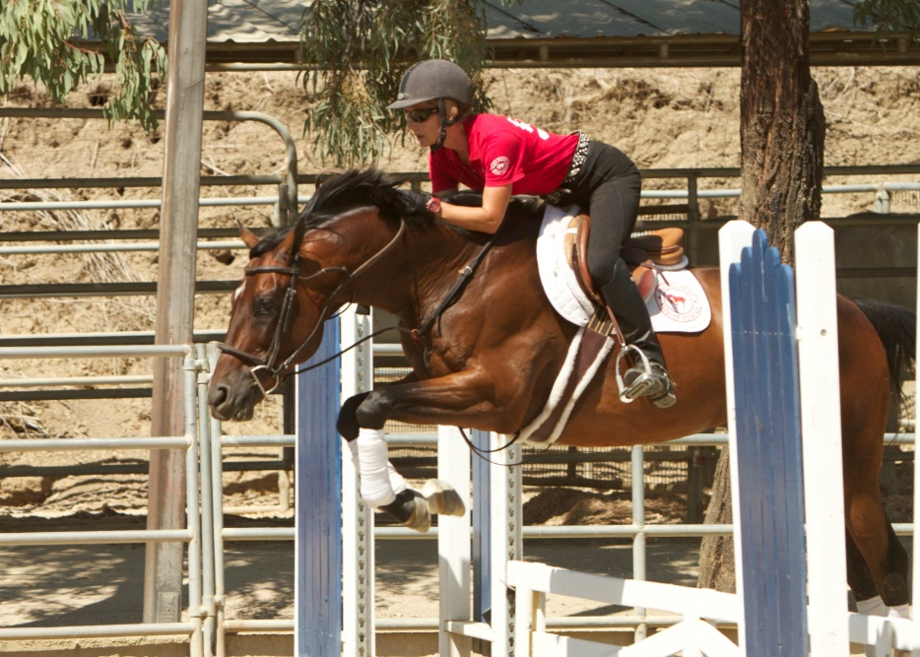
Remember the Culture…The Language
We did this…

Slide 21
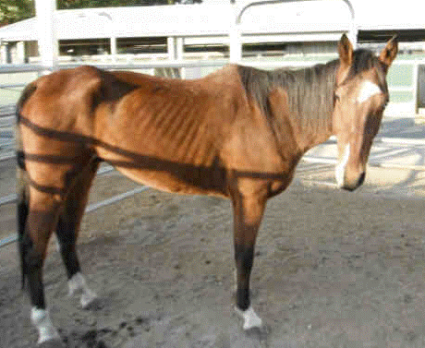
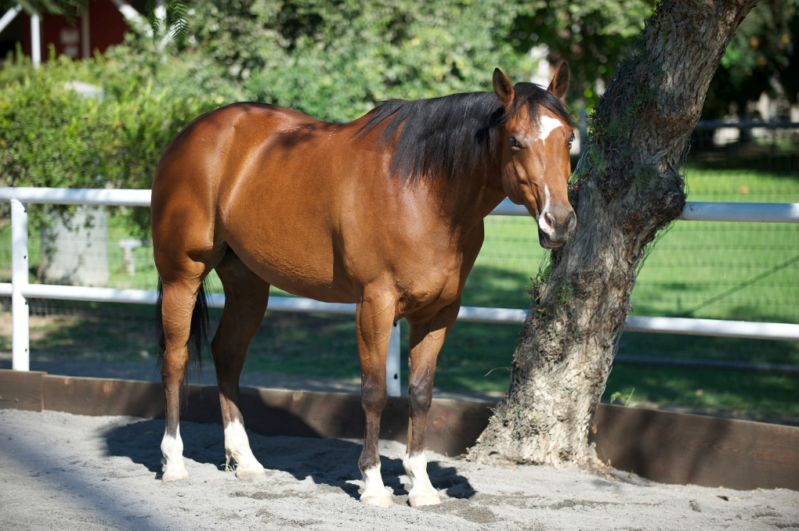
And This …

Slide 22
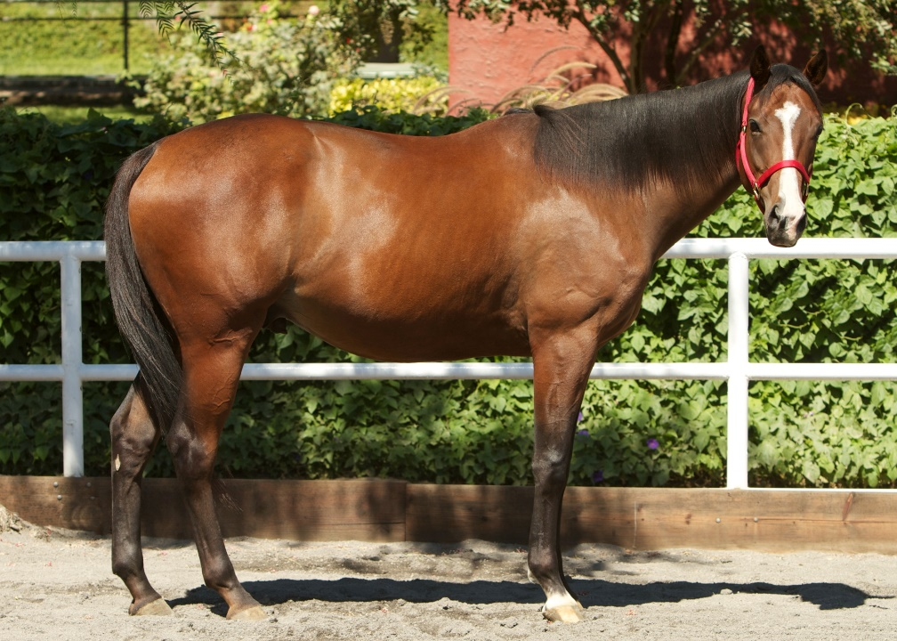
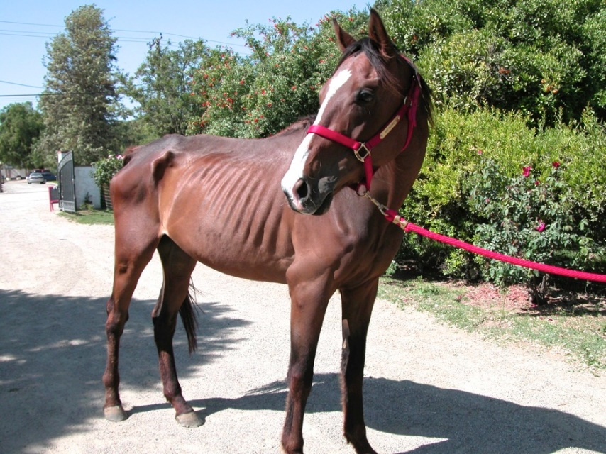
And This …

Slide 23
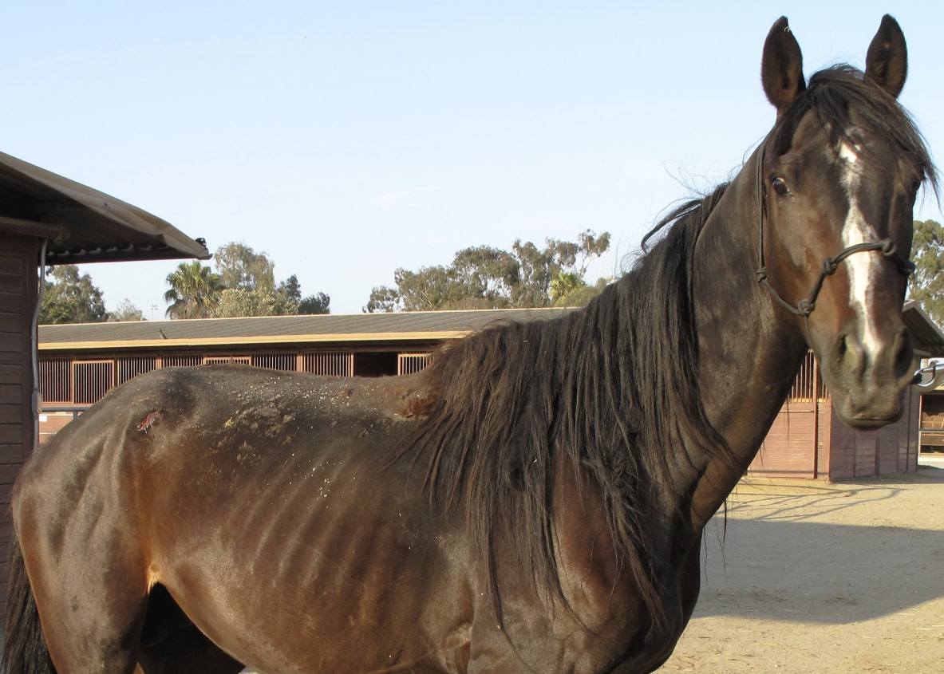
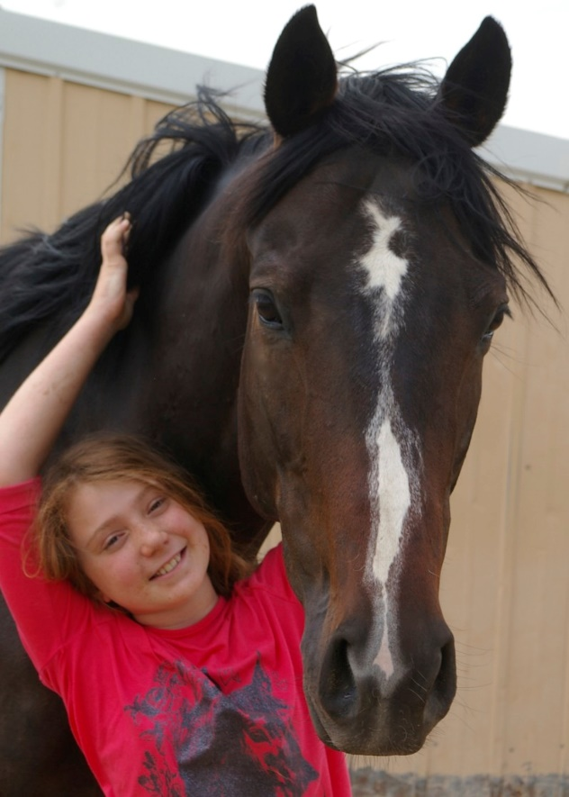
And This …

Slide 24
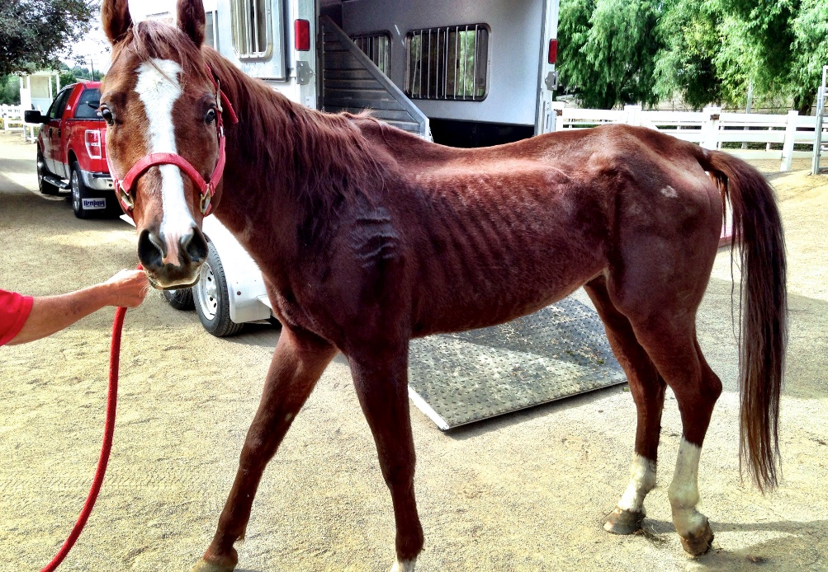
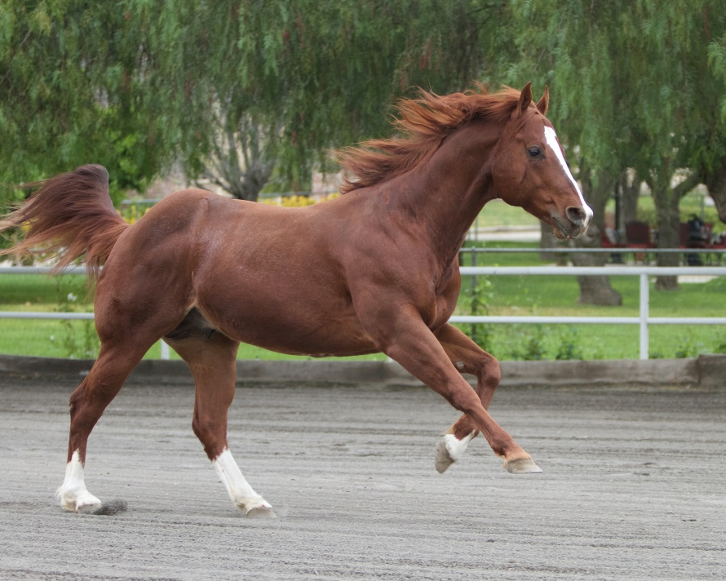
And This …

Slide 25
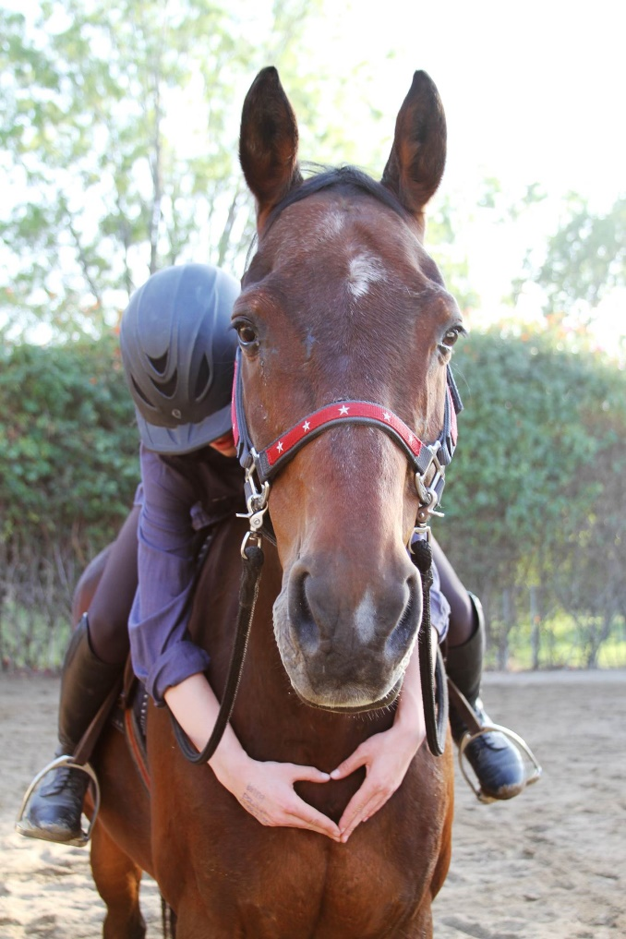
BE BOLD
This is not a practice life
Our rescue is NOT a practice rescue
We want our volunteers to brag!
We want them to know it is because of them

