Slide 1
Adopters Welcome!
Suzanne D’Alonzo
Manager, Strategic Engagement HSUS

Slide 2
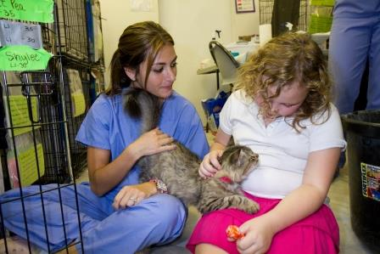

Slide 3
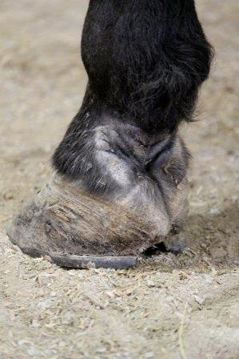
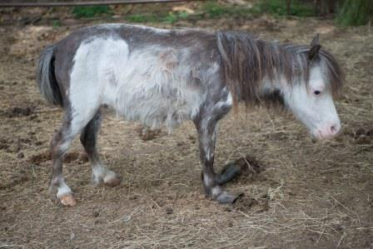
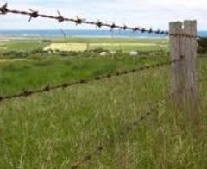
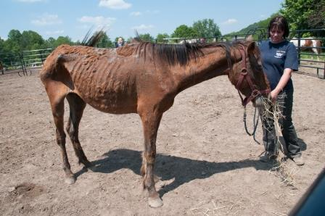
Negativity bias
Tendency to be influenced by negative experiences more than neutral or positive experiences, which can impact our decision making and assessment of risk.

Slide 4
Illusion of control
A belief that we control uncontrollable events. It is stronger when there is an emotional need to control the outcome.
Cause for surrender/intake | Effect on adoption policies
Too many | Require s/n for pets at home
Stray | Adopt indoor-only cats/dogs to homes with fenced yards
Landlord issues | Verify all renters have permission to own pets prior to adoption
Cost | Check with veterinarian to make sure all current pets are up to date

Slide 5
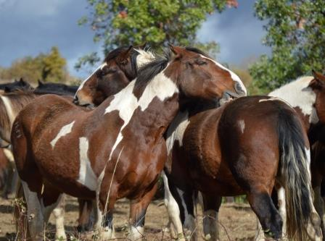
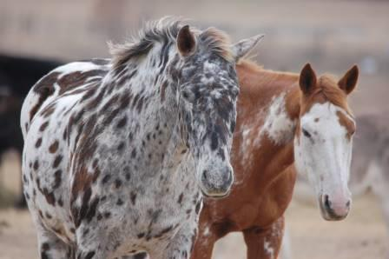
Confirmation bias
Tendency to consider information that confirms our beliefs, even in the face of evidence to the contrary. The effect is also stronger for emotionally charged issues.

Slide 6
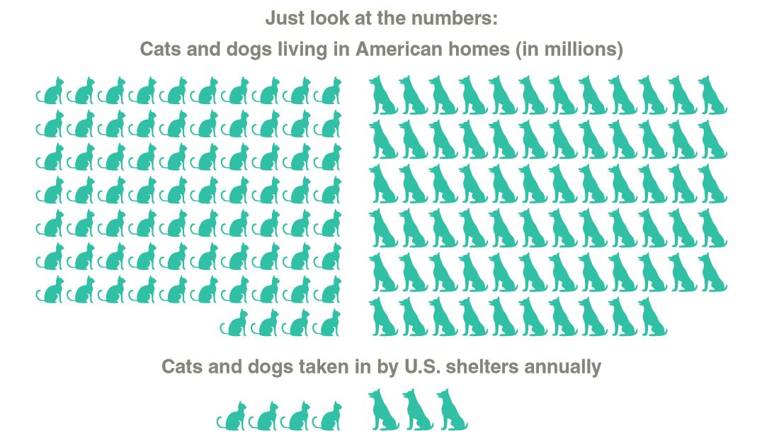
144 Million
6-8 Million
fewer than 6% of pets overall entering shelters each year.
Estimated number of cats and dogs in American homes –AVMA 2012
Estimated number of animals entering shelters in America each year – HSUS 2014

Slide 7
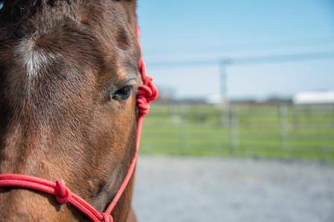
Consider the similar situation of most horses….

Slide 8
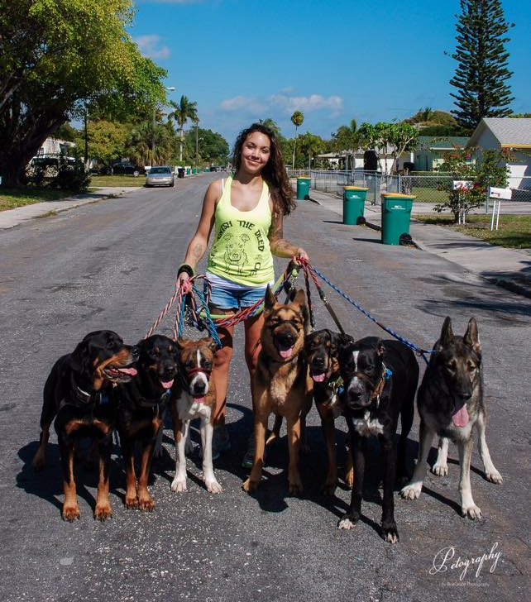
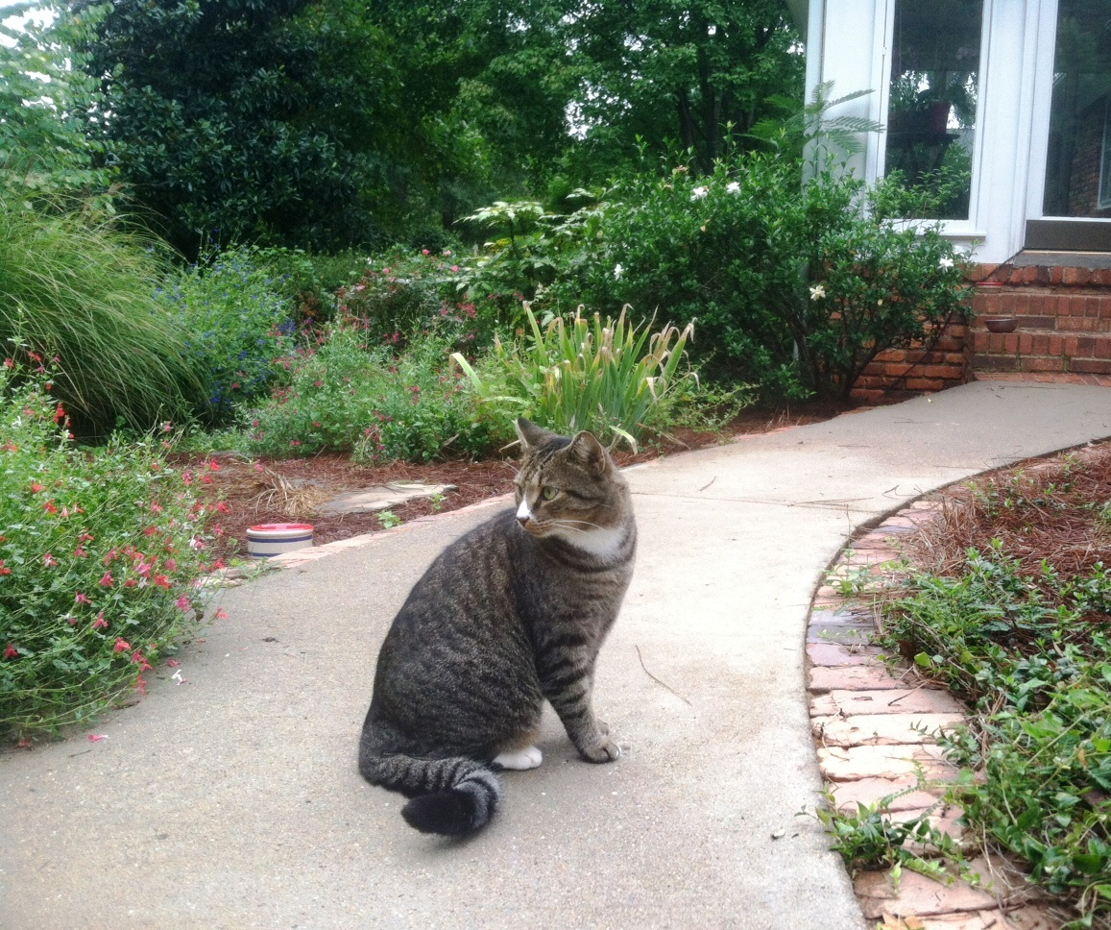
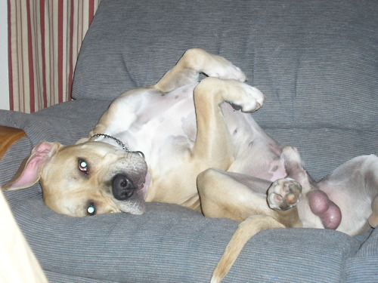
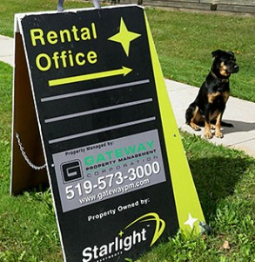
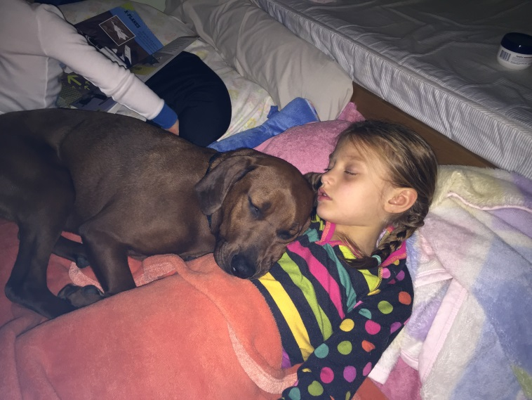
The overwhelming majority: loved and safe
Halloween, Christmas, and Easter are over
You go home and think about it for a day
We “approve” you
We inspect your home
You bring in your pets for a meeting
You bring in all members of your household
You get your current pets spayed or neutered
You install a fence
Your children grow up
You fill out an application
We call your vet
We see proof of home ownership

Slide 9
~ 58% of owned pets come from “other” sources
Top 5 Alternative Sources:
Friends or relatives
Stray (cats)
Breeder (dogs)
Private party
Bred at home
APPA 2013/2014 National Pet Owners Survey

Slide 10
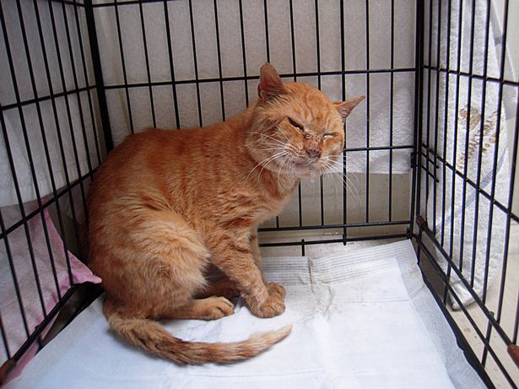
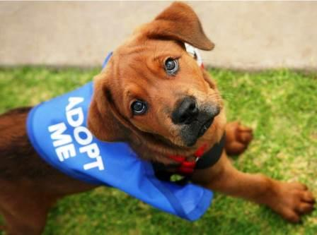
Barriers have Risks
Longer stays risk quality of life.
Resources divert from other pets in your community that need you.
Pets & people are cut off from safety nets.
Less humane options get fueled; your support gets limited.
Euthanasia risk increases… even if not directly experienced.

Slide 11
The overwhelming majority: loved and safe
Halloween, Christmas, and Easter are over
You go home and think about it for a day
We “approve” you
We inspect your home
You bring in your pets for a meeting
You bring in all members of your household
You get your current pets spayed or neutered
You install a fence
Your children grow up
You fill out an application
We call your vet
We see proof of home ownership

Slide 12
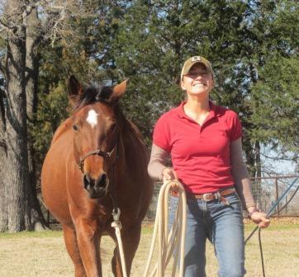
Proactive Approach to Adoption
Let the “Positives” in
Attract & welcome adopters
Reward their choice
Set them up for success
Support them if they need it

Slide 13
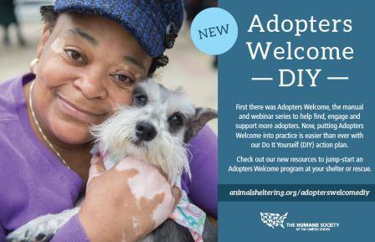

Slide 14
Your animals
Who your policies impact:
Your community & its pets
Your potential adopters
Your actual adopters
Your competition
Your agency

Slide 15
If policy is “Landlord approval required…”
How was it? I’m looking for a dog. . .
We need more time, space, and $! And a home for Frida!
Well, we tried to adopt!
Hell yes I have puppies!

Slide 16
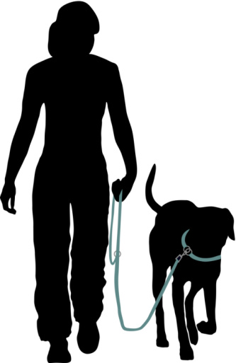
If policy is “Support renters
instead of policing them…”
Thanks for the tip!
Adoption is the only option!
Now we can help Digger!
Maybe I should go back to school…

Slide 17
Use persuasion to address declawing.
Use persuasion to help cats live indoors.
Support homes long-term instead of investigating them once.
Provide tips on how to intro new pets, don’t require “meet-n-greet” unless adopter requests it.
Help adopters keep their dogs happy and healthy whether or not they have a fence.
Help pets live happily with people of all ages.
Treat all dog breeds and types equally.

Slide 18
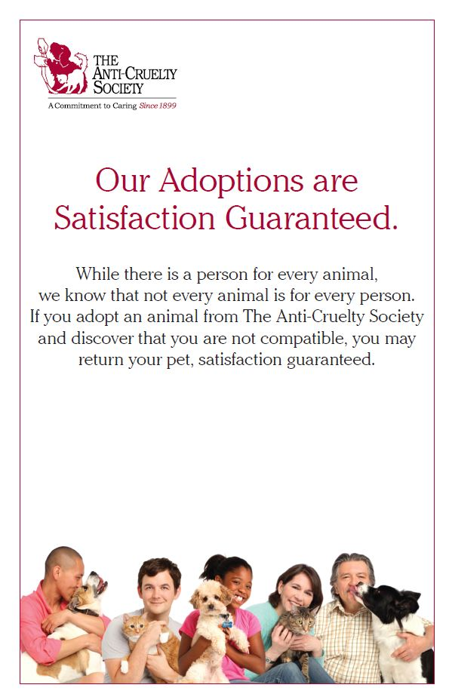
Return policy

Slide 19
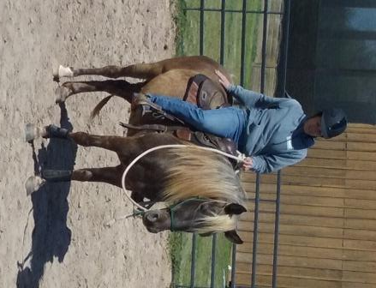
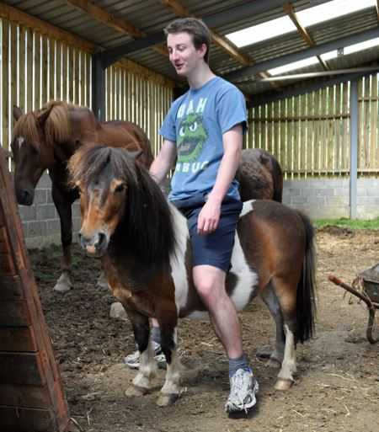
Rehoming policy

Slide 20
Be a Resource

Slide 21
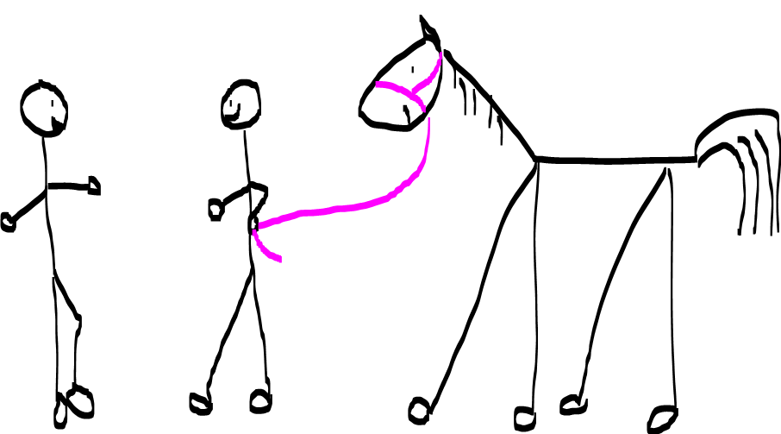
Adopters Welcome approach: both sides share information
Sharing info about me
Listening & sharing info from our group

Slide 22
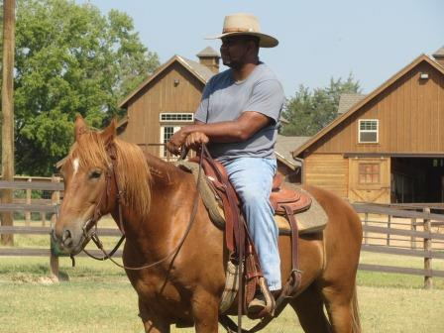
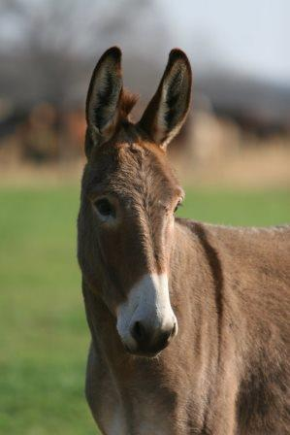
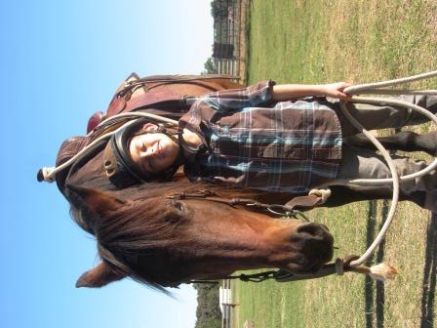
Before you say no…

Slide 23
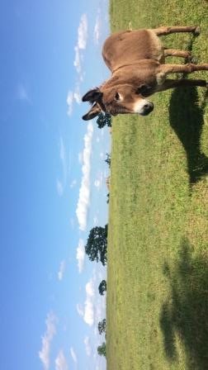
An Adopters Welcome approach
can make you
outstanding in our field!
AdoptersWelcome@humanesociety.org
sdalonzo@humanesociety.org

