Slide 1

Investigations & Evidence
Sr. Investigator D. Michielson
713-869-7722 x 176
dmichielson@houstonspca.org

Slide 2
Building a Case

Slide 3
Investigation
Go to the location of the report and make contact with the suspect/owner of the animals
Evaluate the situation based on what is required by law
Knowledge and intent must be proven
Give suspect notice with timeframe
Take pictures of scene and animals

Slide 4

Investigation (continued)
Follow up on location to check for compliance
Take pictures of the scene and animals again
Evaluate the situation again
  Give another notice
  or
  Start taking necessary steps for seizure/impound

Slide 5
Warrant Application
Law enforcement agency’s duty
The application is based on the facts of the investigation
No opinions should be incorporated into court documents unless they are classified as an expert by the court
Peaceful Entry vs. Forced Entry

Slide 6
Impound & Collection of Evidence
Photograph / video the scene
Scene summary with property outline
Impound items of relevance pertaining to the case (if allowed by warrant)
Catalogue all evidence collected
Medical evidence collection
Document vehicle, registration numbers, witnesses and suspect identities present that have not previously been documented
Animal housing

Slide 7
Medical Evidence
    One of the most important pieces of evidence for animal cruelty cases
    As detailed as possible
    Documented thoroughly

Slide 8
Cruelty Exam
  Basics/Vitals
    Age, Weight, Temperature, Pulse, Respiration, CRT, BCS, and Pain Assessment
  Detailed
    EENT, Respiratory, Cardiovascular, Integument, Musculoskeletal, Gastrointestinal, Neurological, Urinary, Reproductive, Lymphatic, and Endocrine
  Tests Performed with Results
    FIV, Feline Leukemia, Fecal, Heartworm, Skin Scrape
  Vaccines Given/Basic Procedures Performed
    Deworming, Parasite treatment/prevention, Vaccines
  Bloodwork
    With interpretation
  Radiographs
  Assessment
    Overall
  Treatment Plan
    Medications, surgery, other treatment
  Summary
    Layman’s terms and easy-to-understand language

Slide 9

Preservation of Evidence
&
Risk Management
Evidence log
Chain of custody
Limited access to evidence storage
Time management/efficiency

Slide 10
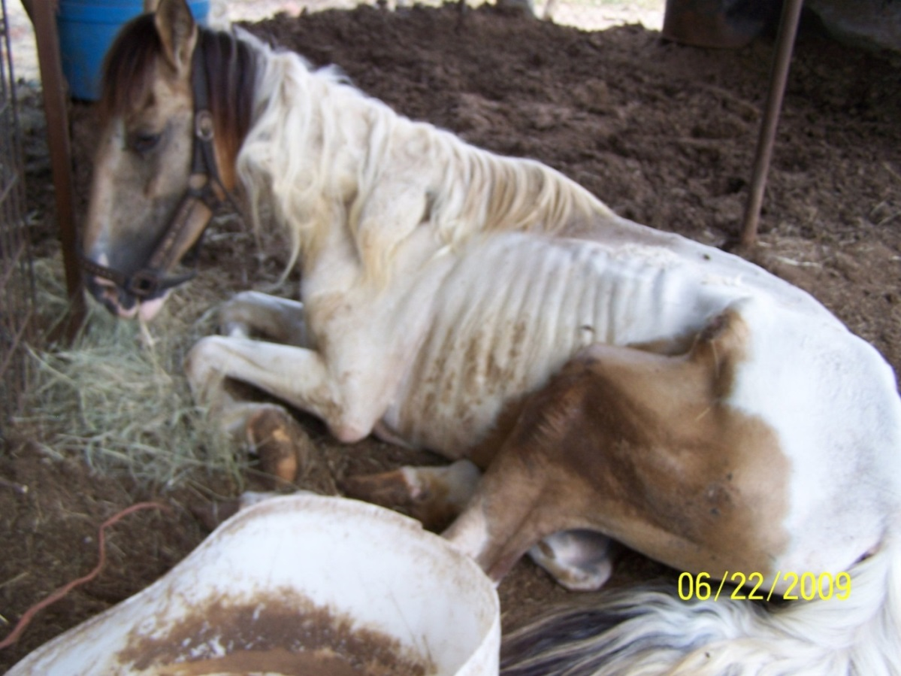
Photos as Evidence

Slide 11
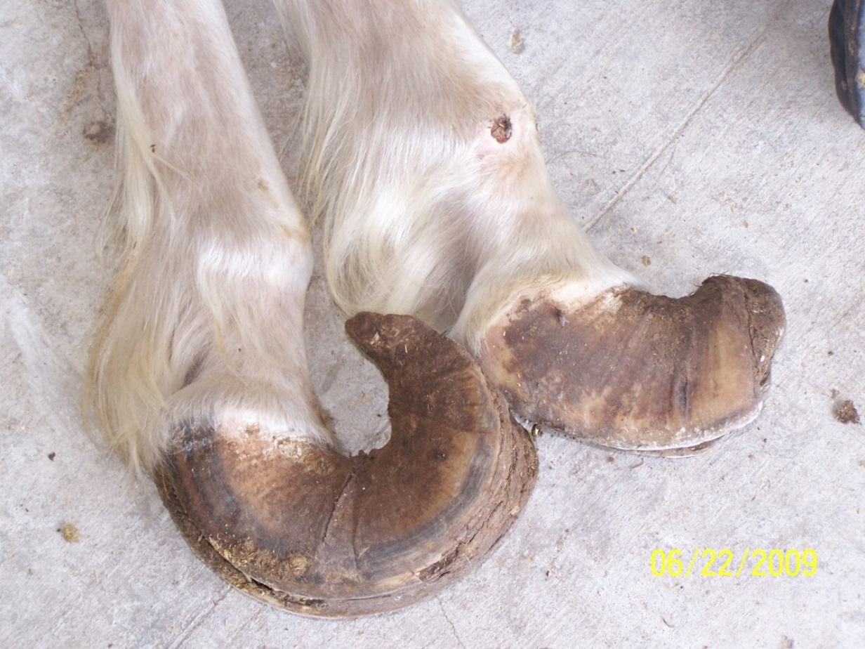
Photos as Evidence

Slide 12
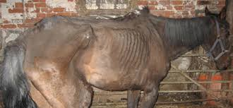
Photos as Evidence

Slide 13
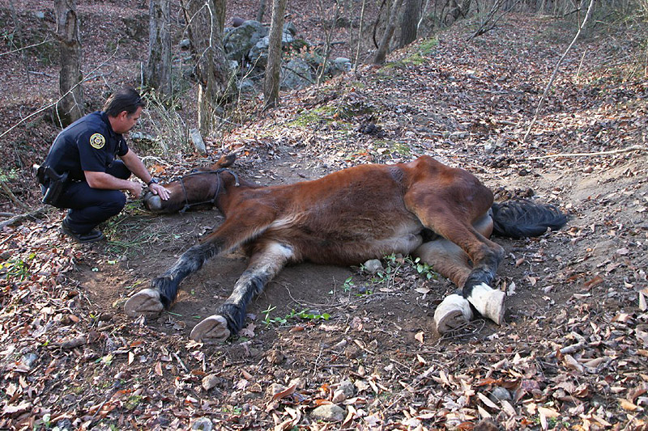
Photos as Evidence

Slide 14
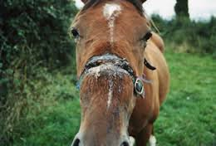
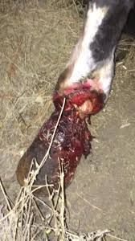
Photos as Evidence

